Slide 1
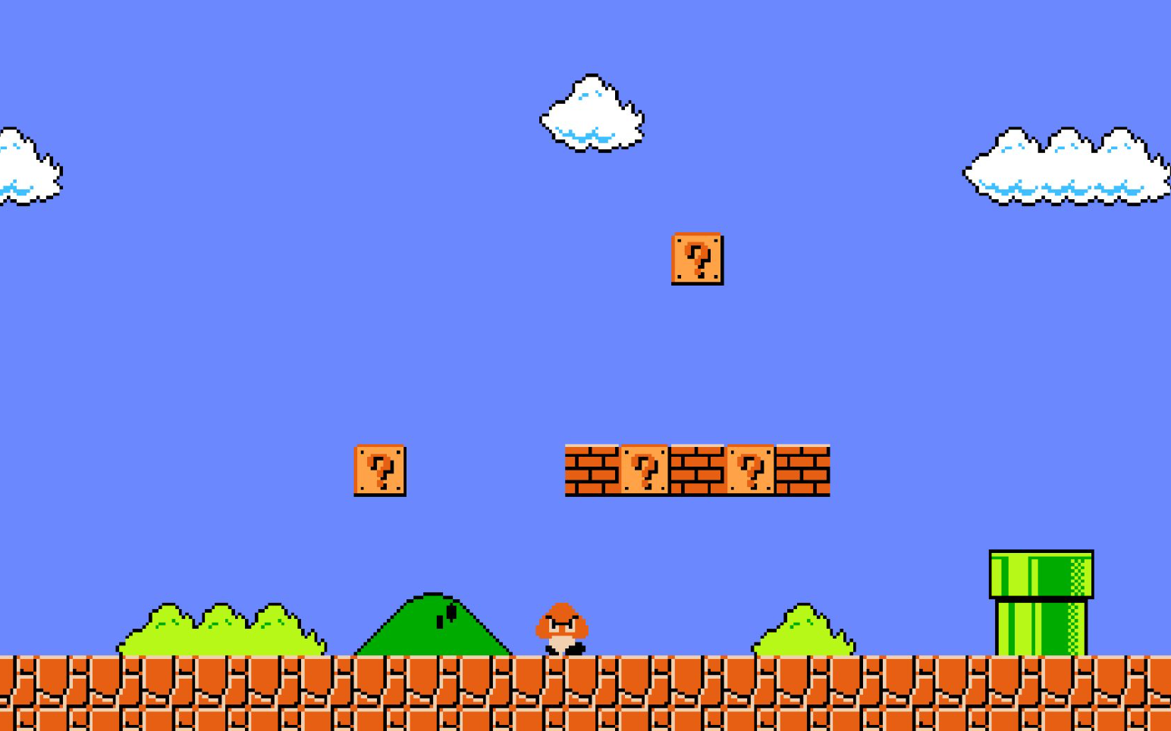

8-Bit Emporium
Project by Team A – Cohort 23052022
Diego Ortiz
Jacob T. Linao
Eric Sweeten
Edward Kennedy

Slide 2
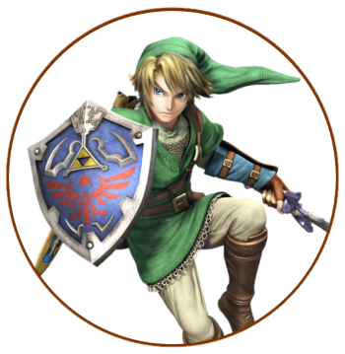



ABOUT US
We are Team A of Revature's Cohort 23052022. This project aims to provide a conceptual platform for prospective retro gamers to purchase and engage with video games from the past!

Slide 3
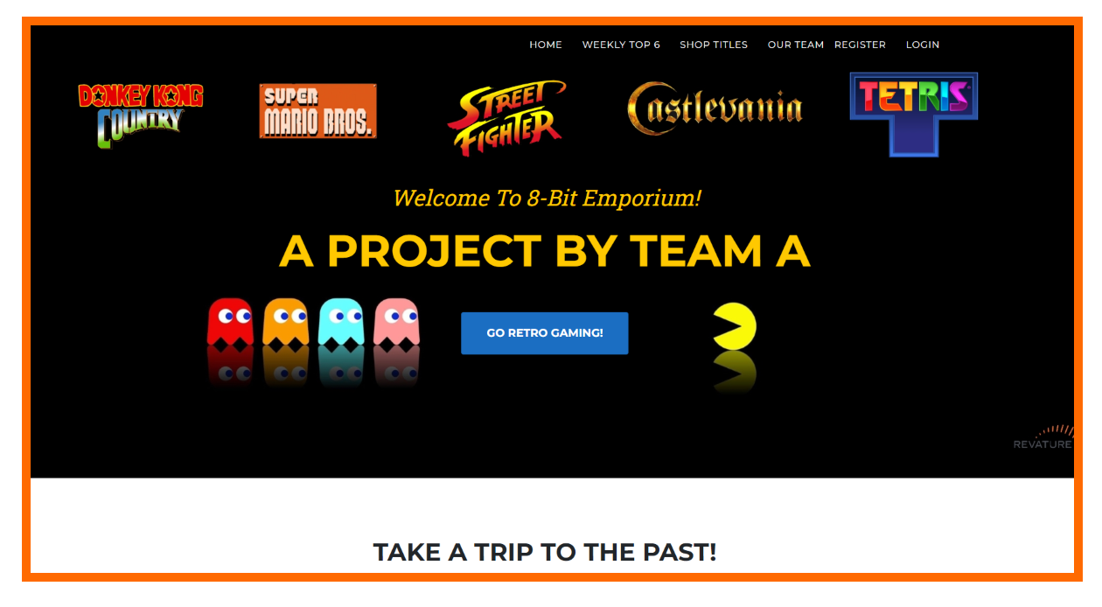
ABOUT US

Slide 4
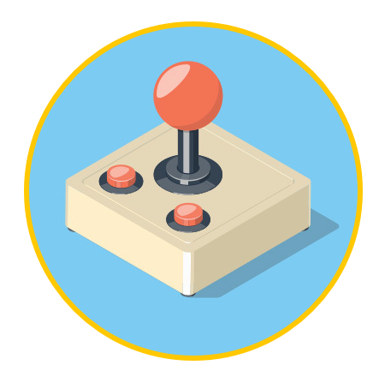
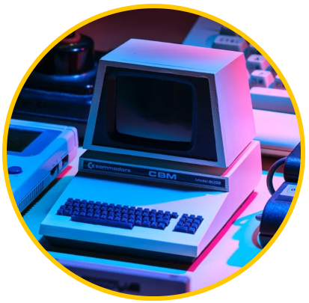
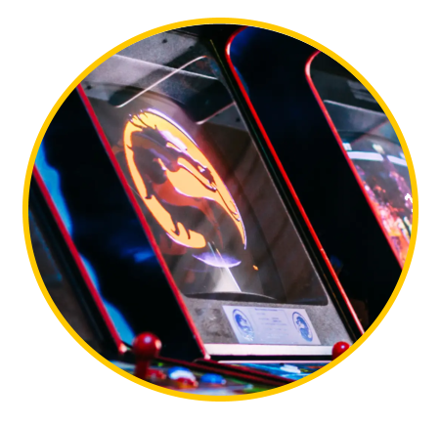
Going Retro
Start
Weekly top titles
Retro gaming is about reliving the nostalgia of our childhood memories and rediscovering the magic of what made video games great!
The top 6 games will become part of our featured titles based on weekly polls and user inputs and interactions!
Explore
Expansions!
With 8-Bit Emporium's platform, you can explore a select variety of our featured retro game titles!
Be immersed alongside a growing community of retro-gamers!
rankings
Millennials account for about a quarter of the $48 billion spent on other products in 2018

Slide 5

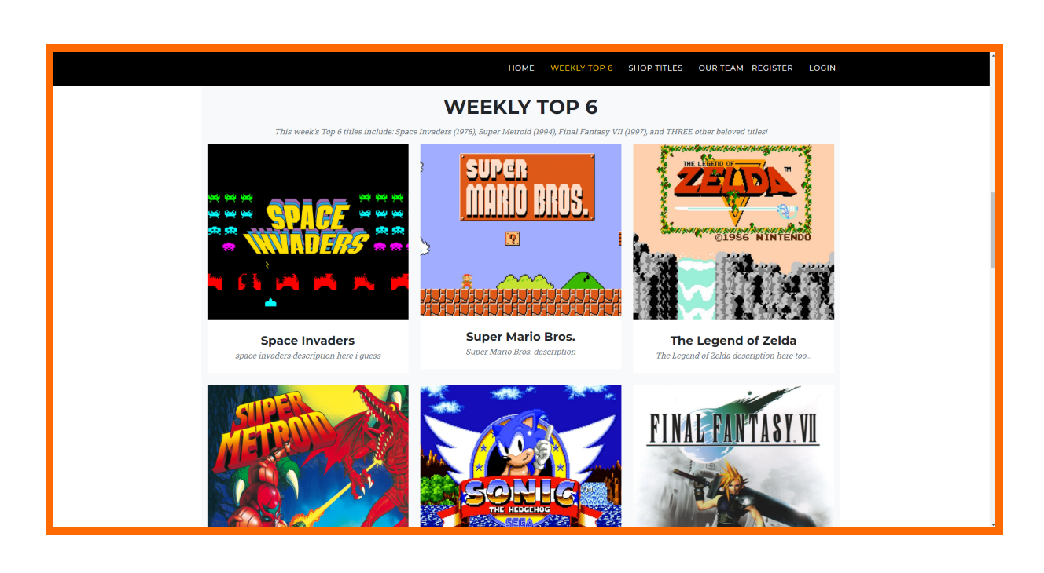
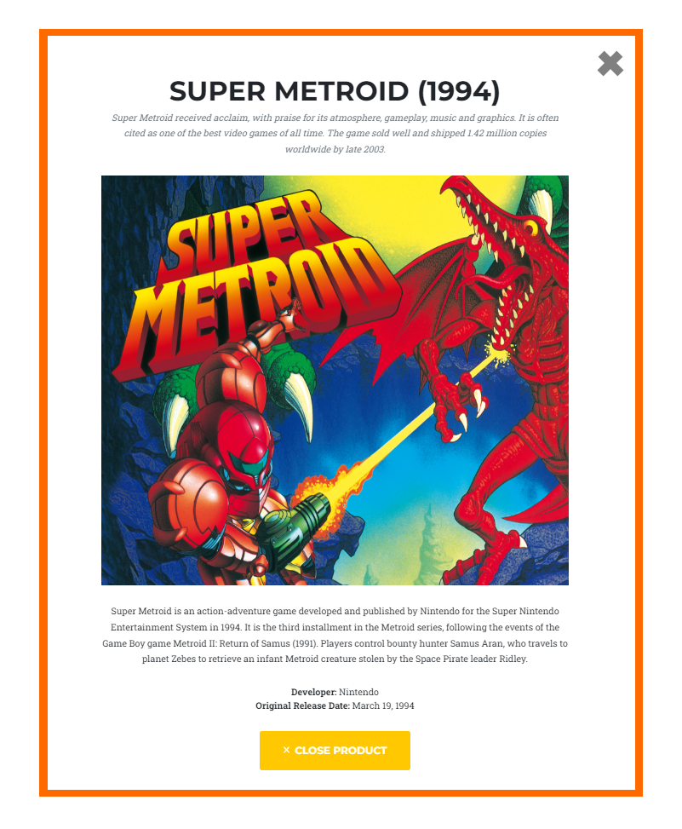
Dynamic Ranking system
User voted rankings
A dynamic user-centered ranking system will be part of 8-Bit Emporiums shopping experience where users can vote on retro titles and show up in the weekly top 6.
These top titles will offer exclusive collectibles and extra goodies that comes with the purchase!

Slide 6
Weekly top 6
Exploring retro
COST SAVINGS
Our weekly top 6 will be titles with the most user traffic based on interactions, favorites, purchased, or weekly polls.
The top 6 titles will have reduced prices based on competitive US market data.
TARGET AUDIENCE
EASY TO USE
All Ages!
No need to cross-check prices from other sources. 8-Bit Emporium is a hub that will do the work for you!

Slide 7

Listed titles +
Cross-Generation
Generation specific
8-Bit Emporium titles are not limited to one generation of consoles or genre of games. As soon as they are available, they will be up for purchase!
Retro games are not immune to console exclusivity. 8-Bit Emporium allows users to tell whether a title is exclusive or not without any hassles.
Version availability
AUTHENTIC
Different remakes and remasters blurs the line of what makes a title “retro” or not. For fans of game franchises, 8-Bit Emporium offers any version regardless whether it is a remake or remaster…
Titles are authentic, but of course if titles become available to play on emulators, 8-Bit Emporium allows offer the freedom to do so by

Slide 8



supplementary tools used
Paint.NET
Visuals and cosmetics asset creation
SVGator
Scalable Vector Graphics for interactivity and screen-space readability
Font Awesome
Pre-made fonts and other webpage necessities to save time

Slide 9


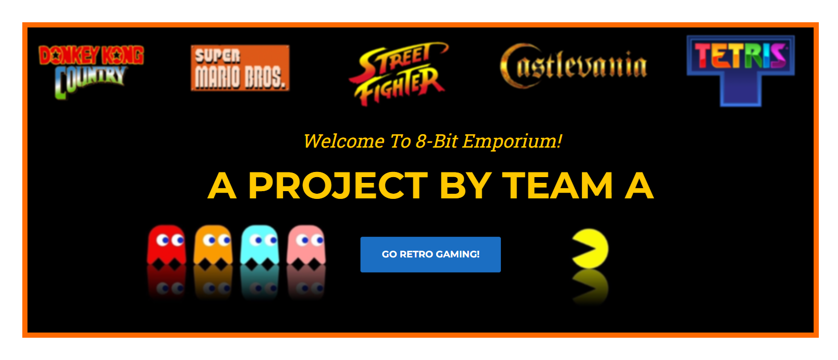
Web asset differences
Comparison to show importance of scalable vector graphics (SVGs)
Without SVG
With SVG

Slide 10
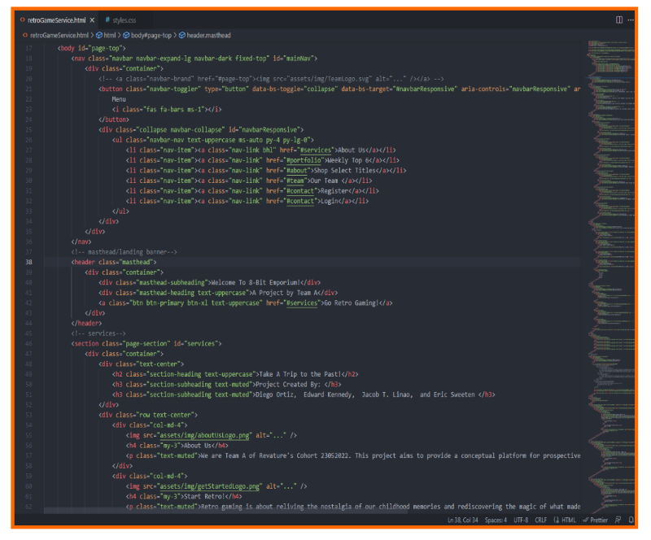




Web technologies

Slide 11
Web technologies
HTML
CSS
Bootstrap
8-Bit Emporium’s web page structure is built on an HTML backbone
CSS is used to add a modern aesthetic to make the web page appealing!
For a responsive web page design with mobile-first front end web page philosophy

Slide 12




Languages & tools
C#
Visual studios
API and MVC application building
Primary tool where the bulk of our applications are made.
Front-end to the API controllers.
Studio code
SQL
Initial stages of developing the front-end was done through Studio Code.
Wide variety of extensions available.
Database design
Database structuring

Slide 13

Expanded shopping experience
Shopping feature
Better shopping functionality will be implemented as variety of titles are added to the shop
Security functionality to be expanded to cover a wider geographic locations to more merchants!

Slide 14
SUMMARY
Avid gamer Eric Sweeten brought up the 8-Bit Emporium project with the idea of providing a place to foster a platform to engage in retro gaming.
Alongside Diego, Edward, and Jacob, the 8-Bit Emporium team worked hard to create a brand new platform where anyone can reconnect and shop for retro videogame titles with competitive prices!

Slide 15
THANK YOU
Project by Team A – Cohort 23052022
Diego Ortiz
Jacob T. Linao
Eric Sweeten
Edward Kennedy

